Slide 1
Secure data hiding in images using steganography
CAPSTONE PROJECT
Presented By:
Student Name : Saurabh Singh
College Name & Department : Rameshwaram Institute of Technology and Management (Computer Science & Engineering Dept.)

Slide 2
OUTLINE
Problem Statement
Technology used
Wow factor
End users
Result
Conclusion
Git-hub Link
Future scope

Slide 3
Problem Statement
With the rise in cyber threats, ensuring the secure communication of sensitive information has become a critical necessity. Traditional encryption methods, while effective, can often be detected, making encrypted data a target for cybercriminals. In contrast, steganography offers a more discreet approach by embedding data within images, making it nearly impossible to identify hidden messages. This project aims to implement a robust method of concealing data within images without introducing noticeable changes, thereby enhancing security and confidentiality. In today's digital world, cybercrimes are occurring at an alarming rate, often going unnoticed. Many individuals remain unaware of the vulnerabilities that exist, making them susceptible to potential attacks. Raising awareness about these threats and adopting advanced security measures such as steganography is essential to safeguarding sensitive data and preventing unauthorized access.

Slide 4
Technology used
cv2.
os
string
python

Slide 5
Wow factors
High security: Data is encrypted before embedding.
Low distortion: Hidden data does not affect image quality.
User-friendly: Simple interface for encoding and decoding data.

Slide 6
End users
Government agencies (secure communication).
Journalists & activists (anonymous messaging).
Businesses (hiding confidential data) .

Slide 7
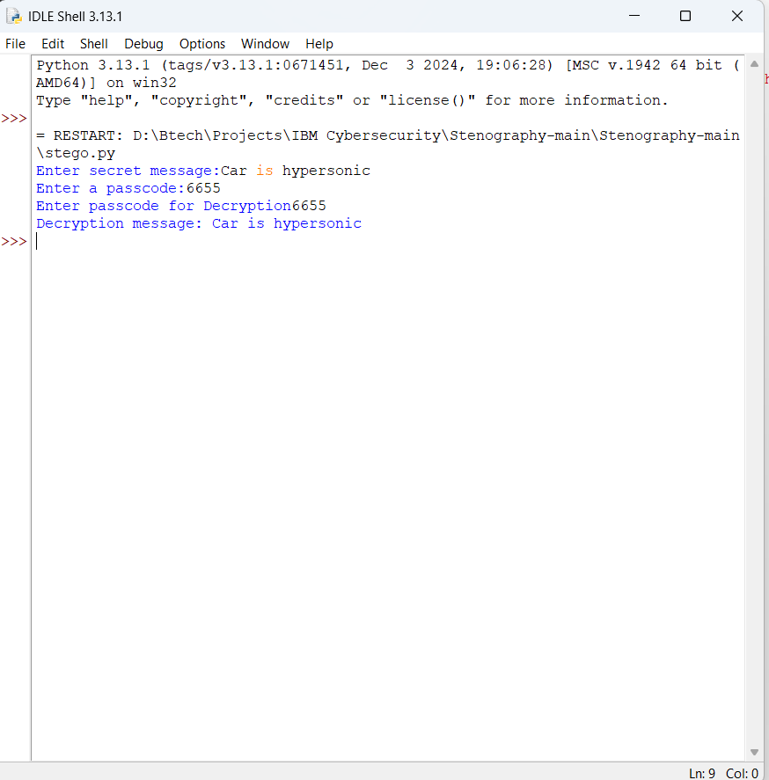
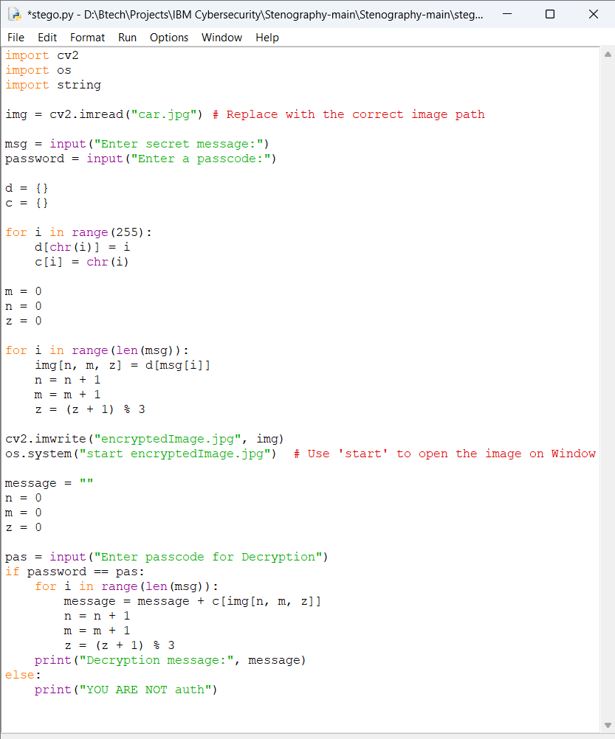
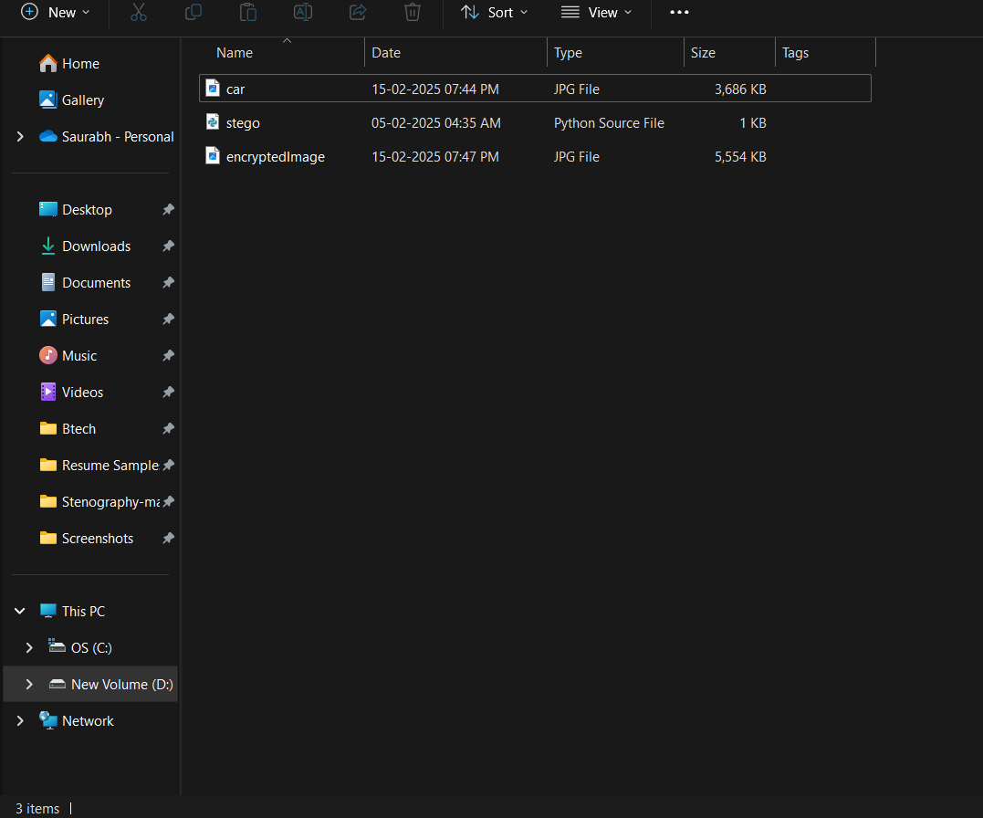
Results

Slide 8
Conclusion
Steganography provides a secure, hidden way to send information.
The project successfully hides & retrieves data without quality loss.
Future improvements can increase capacity & resistance to detection.

Slide 9
GitHub Link
https://github.com/saurabh1723singh/Secure-data-hiding-in-images-using-steganography.git

Slide 10
Future scope(optional)
Support for Multiple File Formats
Expanding steganography to audio, video, and document files for broader applications.
AI-Based Detection Resistance
Implementing machine learning algorithms to enhance security against steganalysis (detection techniques).
Increased Data Capacity
Optimizing algorithms to store more data while maintaining image quality and avoiding suspicion.
Cloud & Network Security Integration
Using steganography for secure cloud storage and data transmission over networks to prevent cyber threats.
Real-Time Encryption & Hiding
Developing a real-time tool for secure communication using instant image processing and data embedding.

Slide 11
THANK YOU

